Slide 1



Sales report
View in Power BI
Last data refresh:
6/11/2025 7:06:36 AM UTC
Downloaded at:
6/11/2025 7:09:28 AM UTC

Slide 2
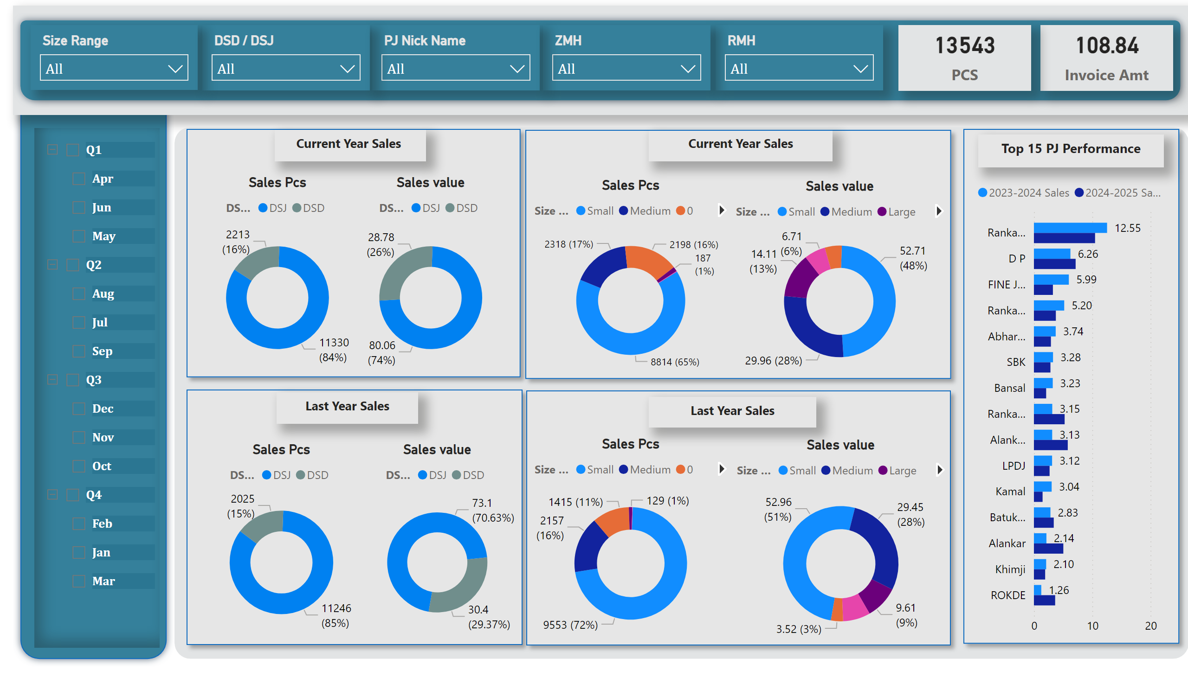
Over View
Notes:
shape
No alt text provided
shape
No alt text provided
shape
No alt text provided
slicer
No alt text provided
slicer
No alt text provided
slicer
No alt text provided
slicer
No alt text provided
slicer
No alt text provided
slicer
No alt text provided
card
No alt text provided
card
No alt text provided
textbox
No alt text provided
shape
No alt text provided
textbox
No alt text provided
shape
No alt text provided
textbox
No alt text provided
shape
No alt text provided
textbox
No alt text provided
shape
No alt text provided
textbox
No alt text provided
shape
No alt text provided
Sales Pcs
No alt text provided
Sales value
No alt text provided
Sales Pcs
No alt text provided
Sales value
No alt text provided
Sales Pcs
No alt text provided
Sales value
No alt text provided
Sales Pcs
No alt text provided
Sales value
No alt text provided
clusteredBarChart
No alt text provided

Slide 3
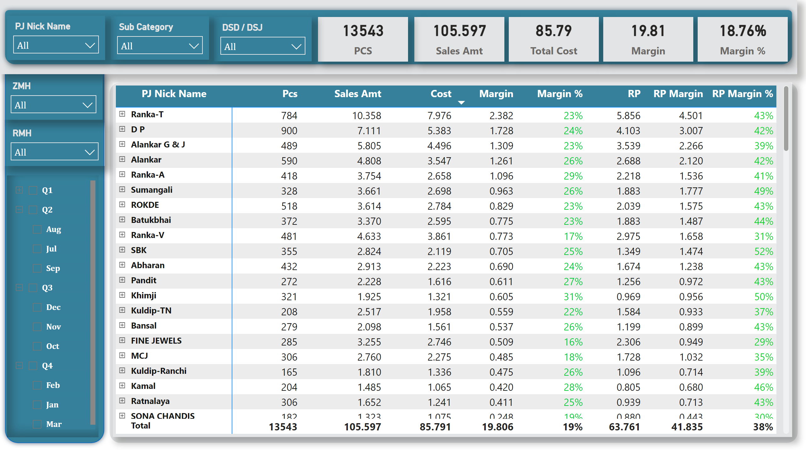
PJ wise report
Notes:
shape
No alt text provided
shape
No alt text provided
shape
No alt text provided
pivotTable
No alt text provided
slicer
No alt text provided
slicer
No alt text provided
slicer
No alt text provided
slicer
No alt text provided
card
No alt text provided
card
No alt text provided
slicer
No alt text provided
slicer
No alt text provided
card
No alt text provided
card
No alt text provided
card
No alt text provided

Slide 4
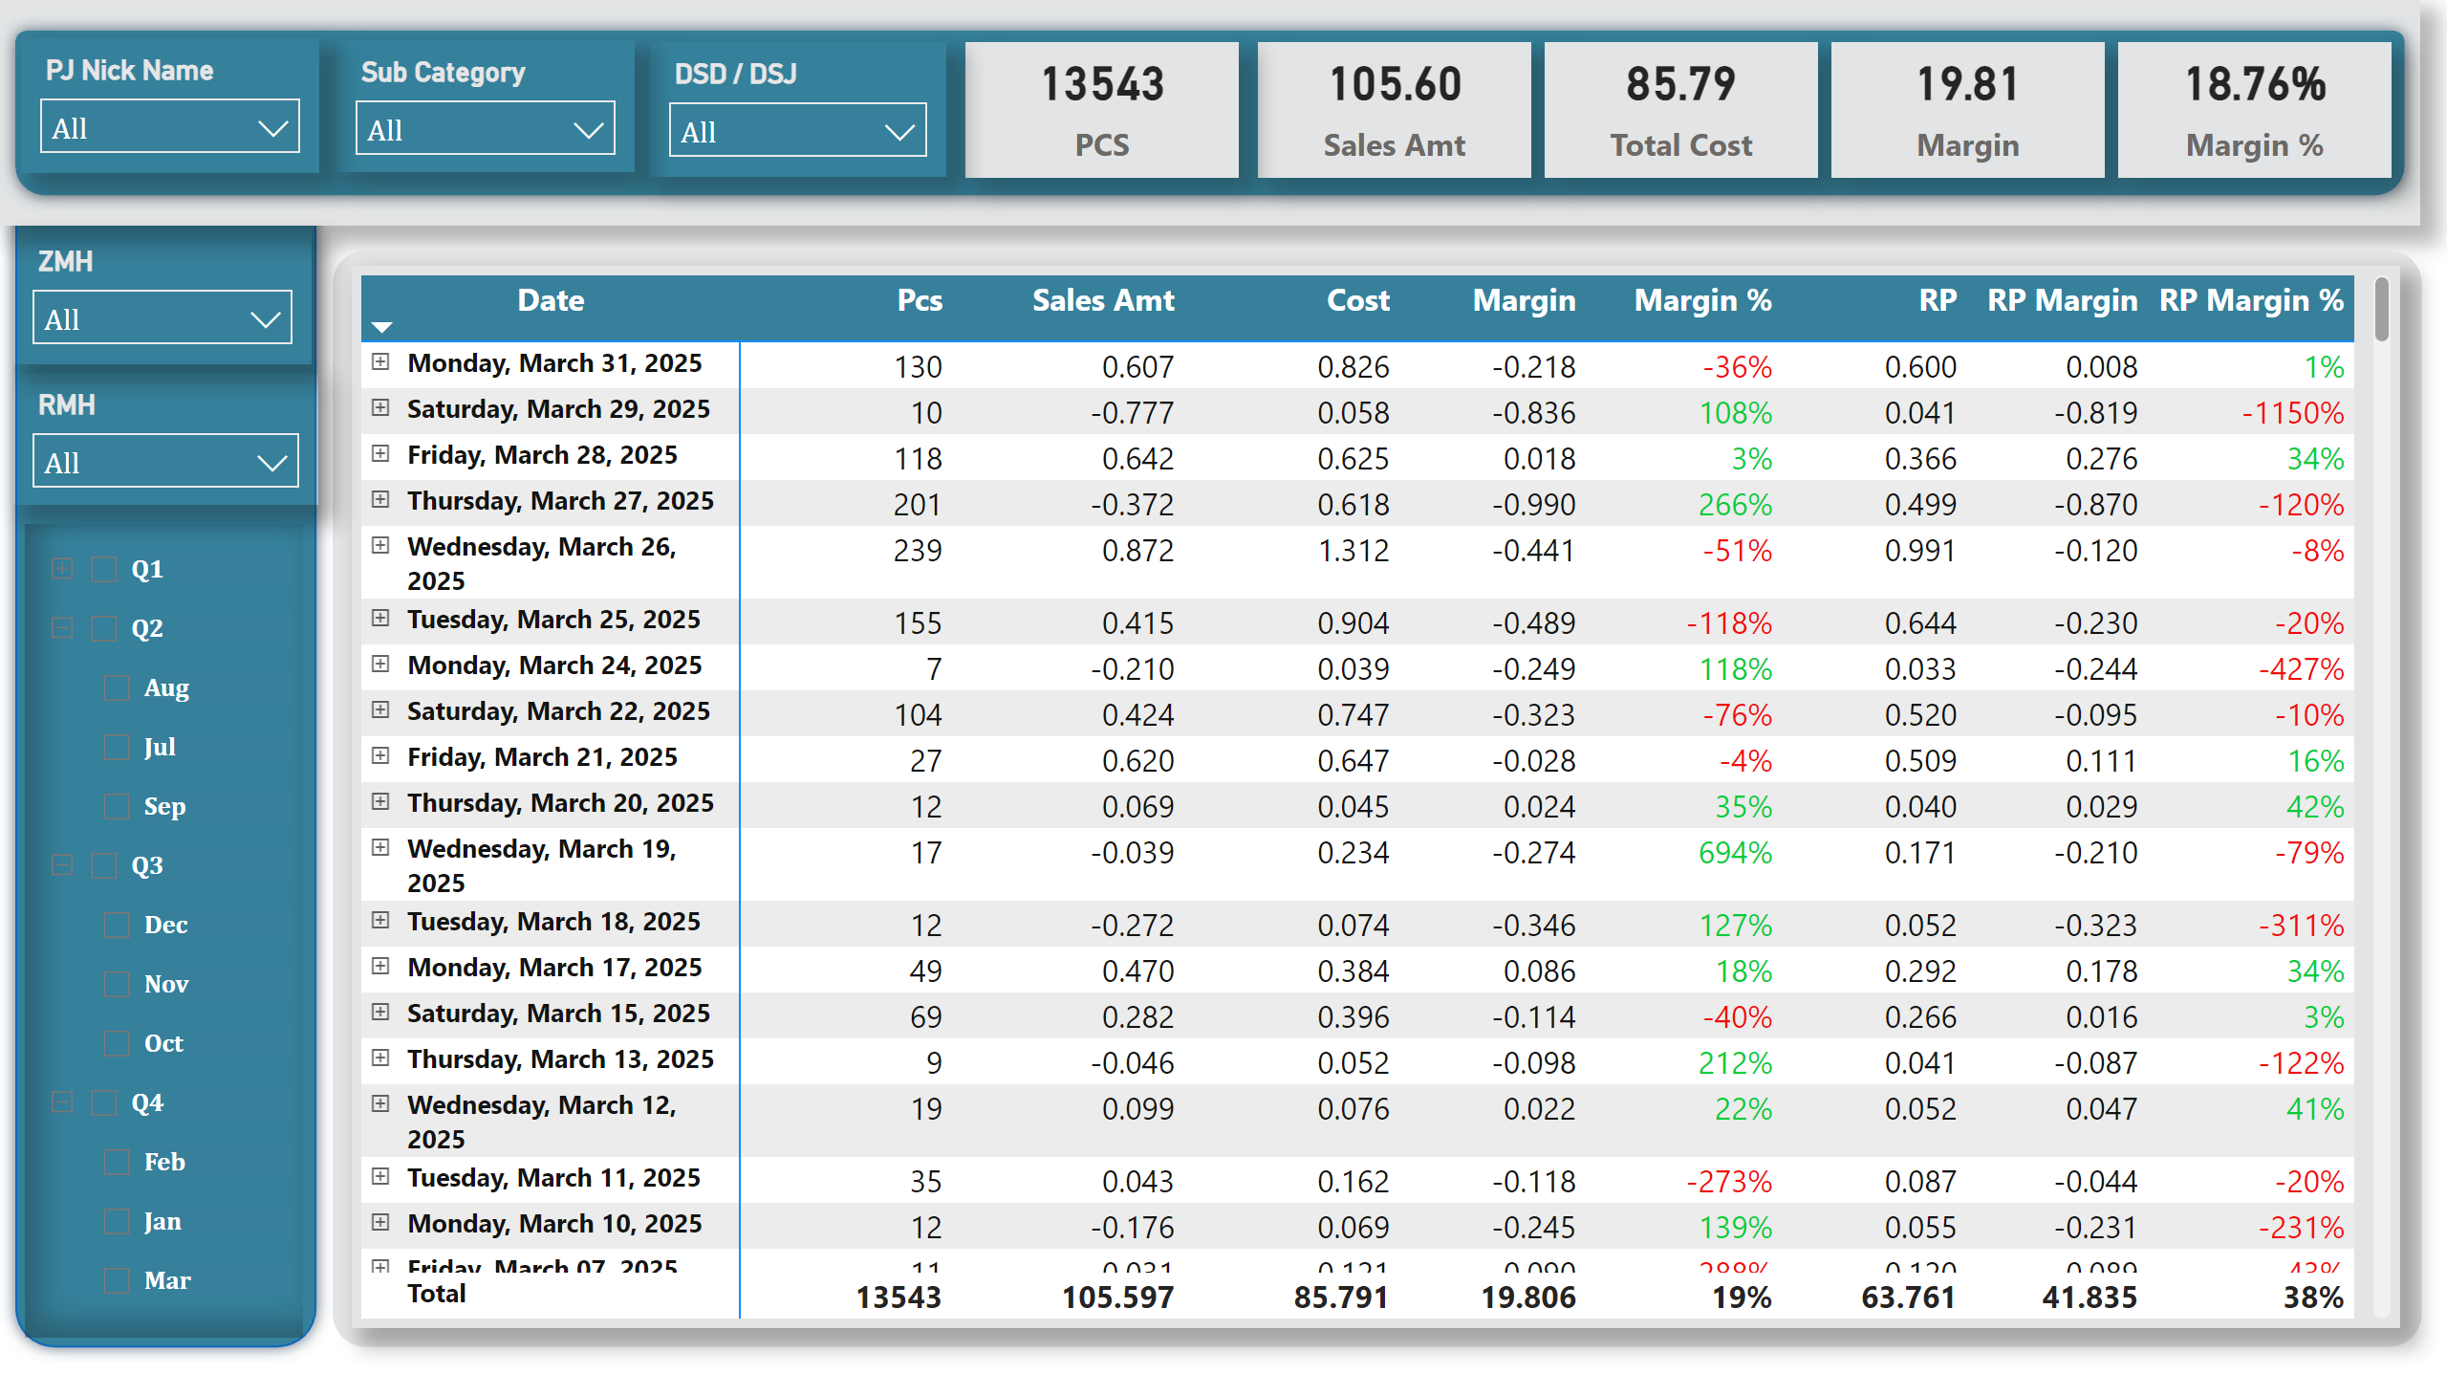
Date Wise Invoice report
Notes:
shape
No alt text provided
shape
No alt text provided
shape
No alt text provided
pivotTable
No alt text provided
slicer
No alt text provided
slicer
No alt text provided
slicer
No alt text provided
card
No alt text provided
card
No alt text provided
card
No alt text provided
card
No alt text provided
card
No alt text provided
slicer
No alt text provided
slicer
No alt text provided
slicer
No alt text provided

Slide 5
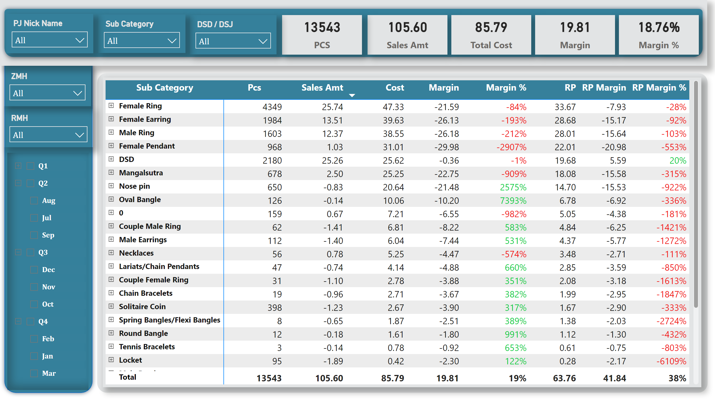
Product Wise
Notes:
shape
No alt text provided
shape
No alt text provided
shape
No alt text provided
slicer
No alt text provided
slicer
No alt text provided
slicer
No alt text provided
card
No alt text provided
card
No alt text provided
card
No alt text provided
card
No alt text provided
card
No alt text provided
slicer
No alt text provided
slicer
No alt text provided
slicer
No alt text provided
pivotTable
No alt text provided

Slide 6
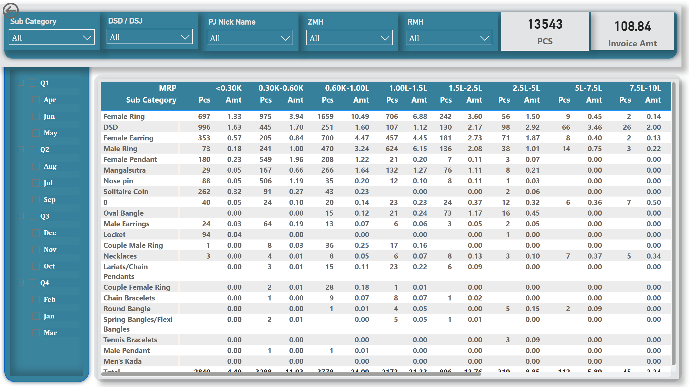
Ticket Size
Notes:
shape
No alt text provided
shape
No alt text provided
shape
No alt text provided
pivotTable
No alt text provided
card
No alt text provided
slicer
No alt text provided
slicer
No alt text provided
slicer
No alt text provided
slicer
No alt text provided
slicer
No alt text provided
slicer
No alt text provided
card
No alt text provided
actionButton
No alt text provided

Slide 7
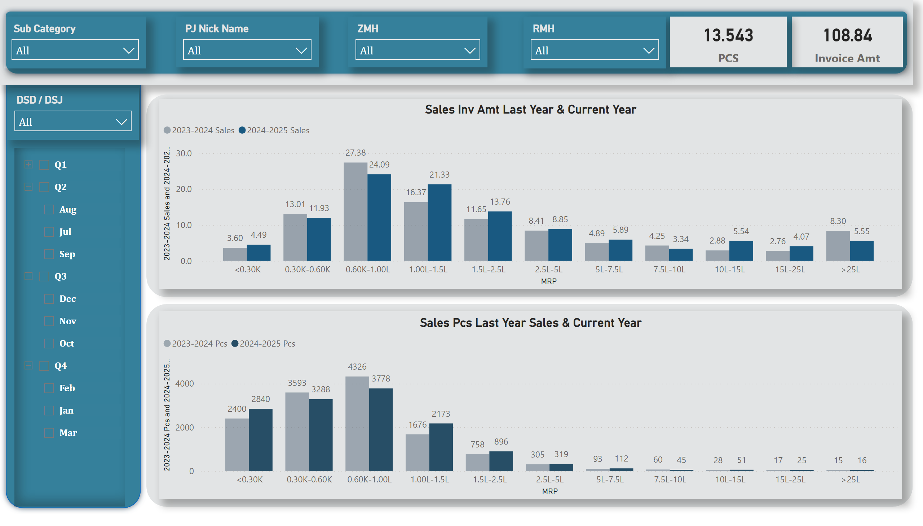
Ticket Size
Notes:
slicer
No alt text provided
slicer
No alt text provided
slicer
No alt text provided
card
No alt text provided
card
No alt text provided
slicer
No alt text provided
Sales Pcs Last Year Sales & Current Year
No alt text provided
Sales Inv Amt Last Year & Current Year
No alt text provided
slicer
No alt text provided
slicer
No alt text provided
shape
No alt text provided
shape
No alt text provided
shape
No alt text provided
shape
No alt text provided

